Slide 1
Computationally Limited Monographic Optical Flow Tracking
Thomas Lux
Using a single camera video to track the movement of objects for the purpose of robotic navigation in three dimensional space.

Slide 2
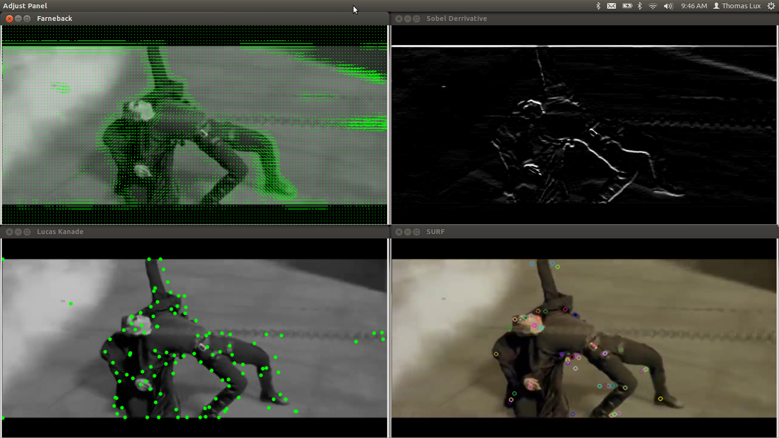
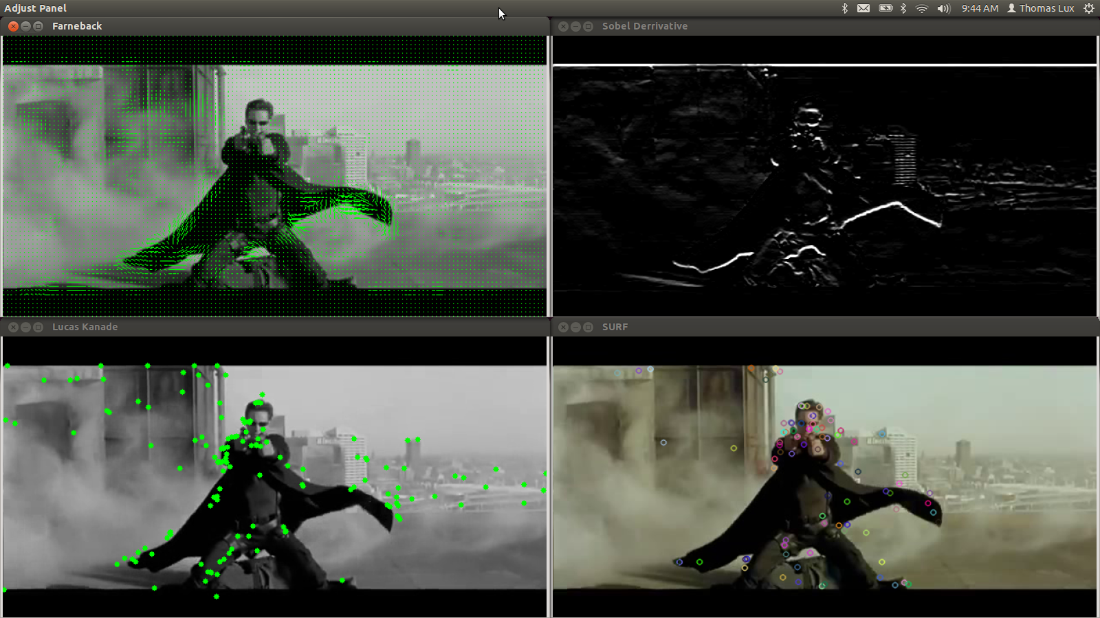
Testing Known Algorithms

Slide 3
Cool! But why?
Cameras are mass produced, videos are everywhere!
Smartphones and other small computing devices are readily available.
Mobile robots require lightweight hardware and have limited computing power.

Slide 4
Challenges
Turning my thoughts into words used by previous works.
Getting previously created algorithms to work.
Knowing when it is better to be creative and follow my thoughts versus when I should focus on finding and understanding previous works.

Slide 5
Any thoughts?

